Slide 1

Using Microsoft Flow with Dynamics 365
DYNAMICS 365

Slide 2

Mitch Milam
Dynamics CRM Architect
mitch@xrmcoaches.com
@mitchmilam
http://tinyurl.com/MitchMilamLinkedIn

Slide 3
Future Events
Webinar: Dynamics 365: Business Rules Revisited
With the changes to the Business Rule Designer introduced in Dynamics 365, I thought it would be a good idea to revisit the creation and use of Business Rules for Dynamics 365.
Fri, Feb 3, 2017 10:00 AM - 11:00 AM CST

Slide 4
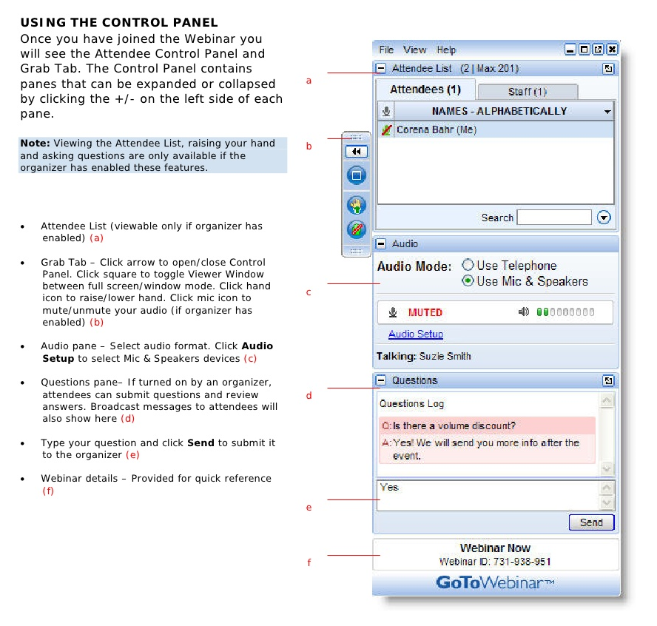
Webinar Housekeeping

Slide 5



2017 Training Roadmap
Webinars
http://www.xrmcoaches.com/webinars
KnowledgeBits
http://www.xrmcoaches.com/knowledgebits
Learning Plans
http://www.xrmcoaches.com/freestuff
More Goodies
Practice tests
On–Demand video training
Instructor–led training
Books

Slide 6
Agenda
Pricing
Components
Design
Final thoughts

Slide 7
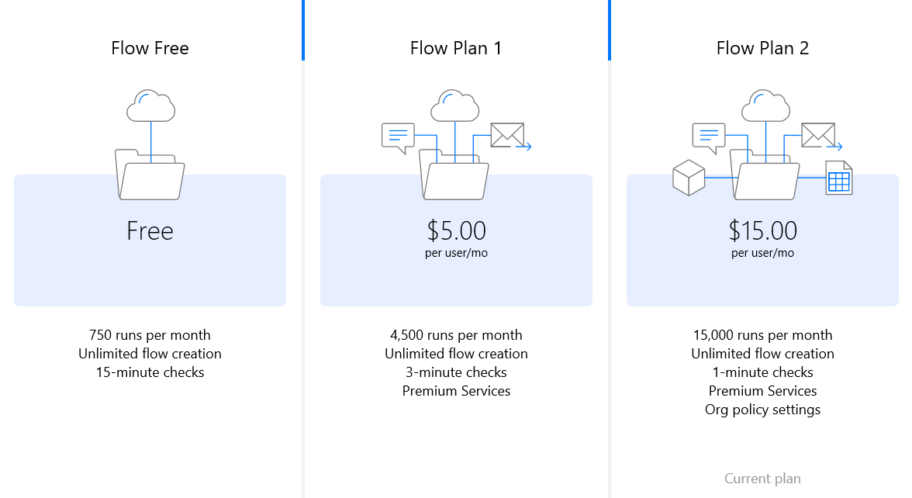
Pricing

Slide 8
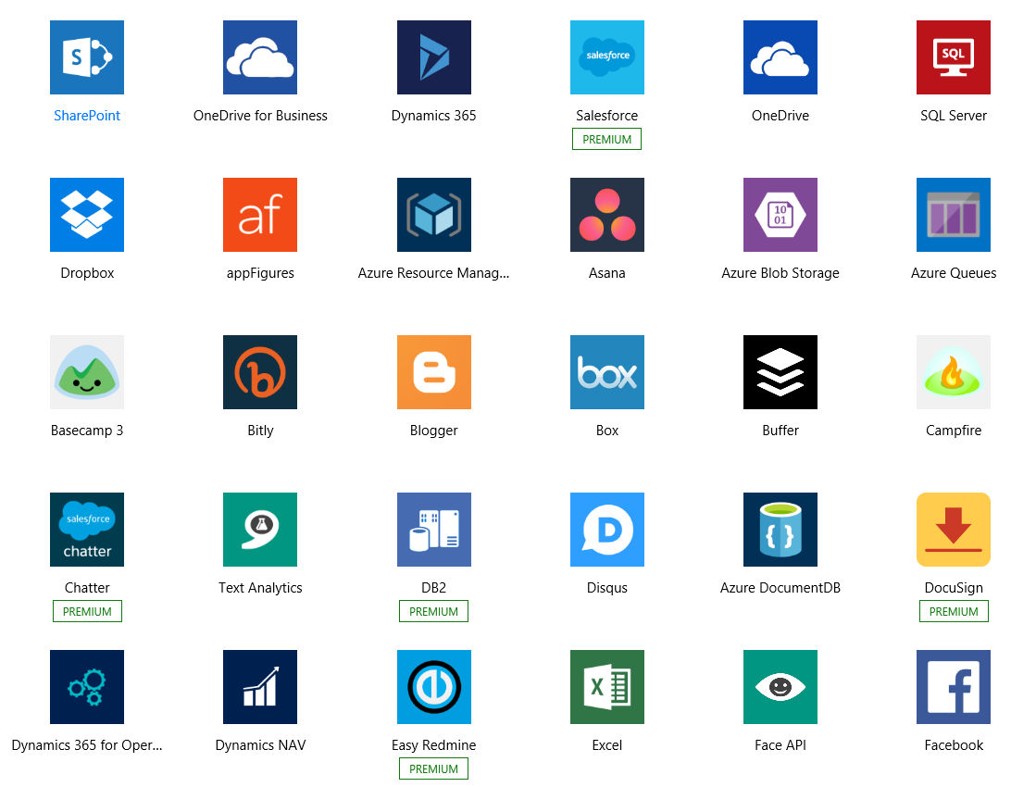
Services
Notes:
91 services

Slide 9
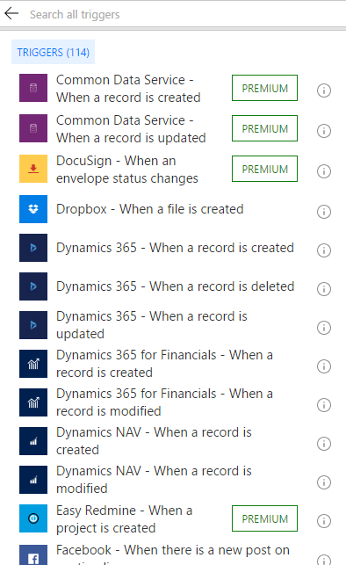
Triggers

Slide 10
Triggers
When an event occurs
Manual
Scheduled

Slide 11
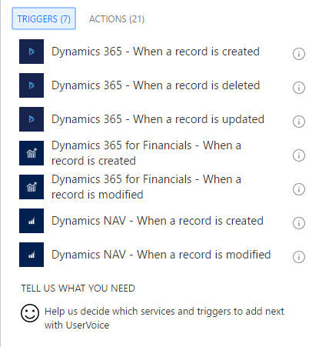
Dynamics 365 Triggers

Slide 12
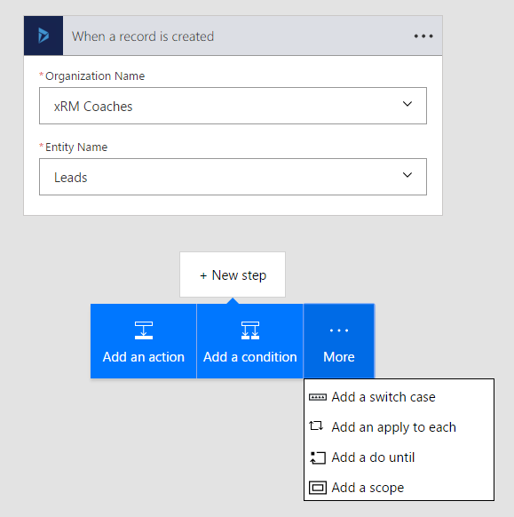
Actions

Slide 13
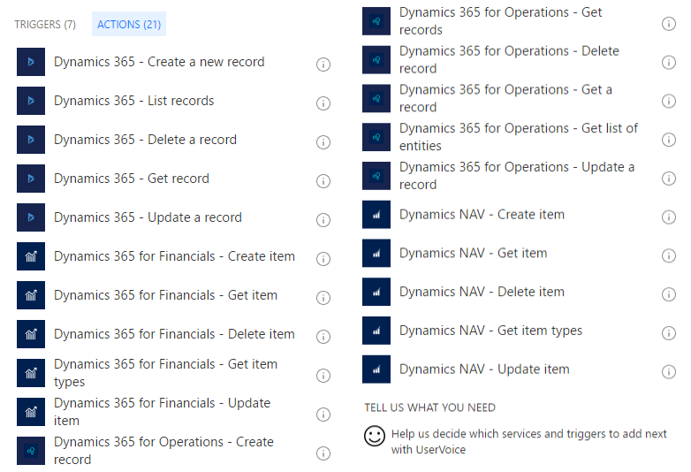
Dynamics 365 Actions

Slide 14
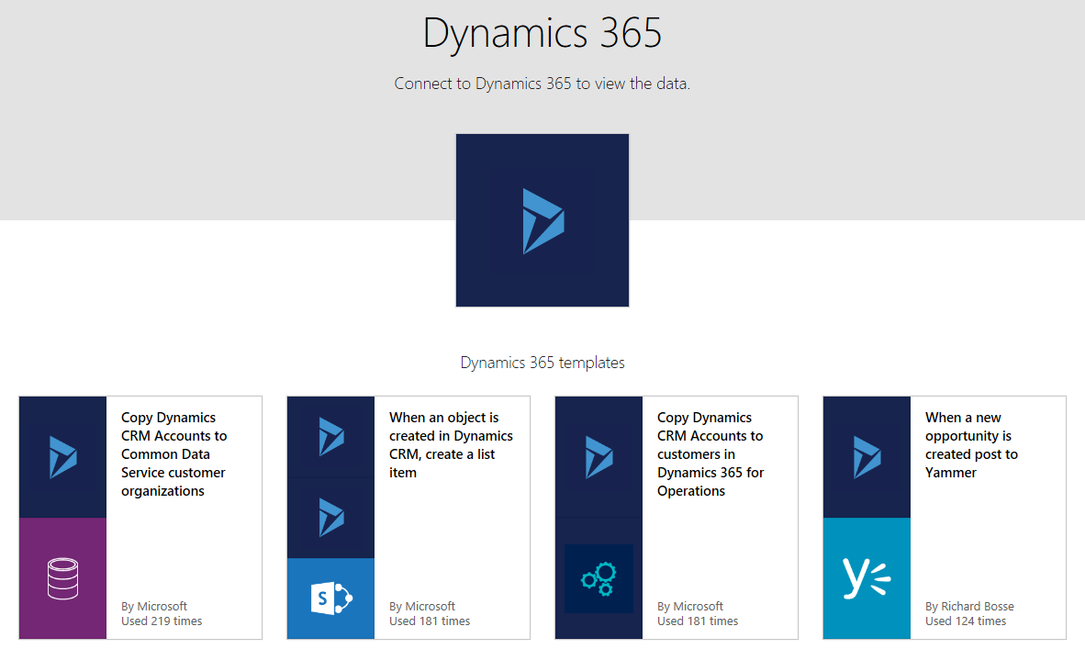
Dynamics 365 Templates

Slide 15
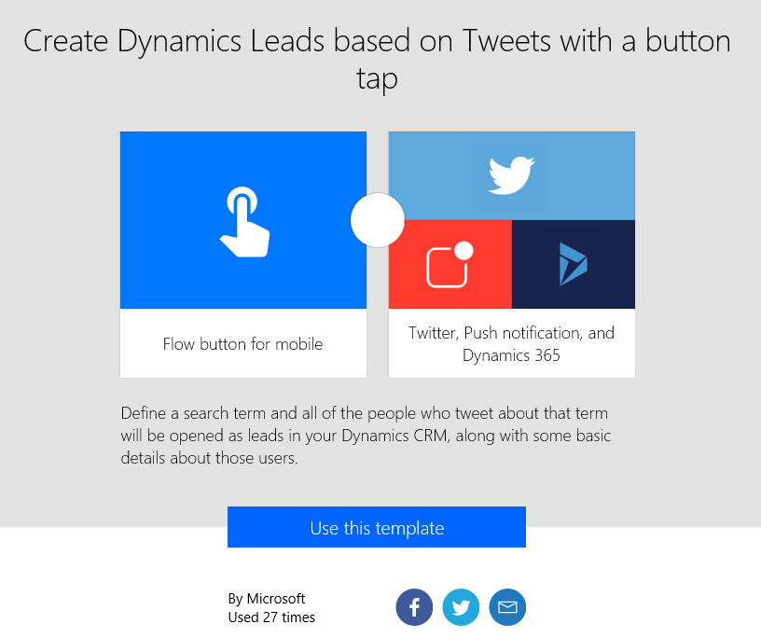
Creating a Flow from a Template

Slide 16
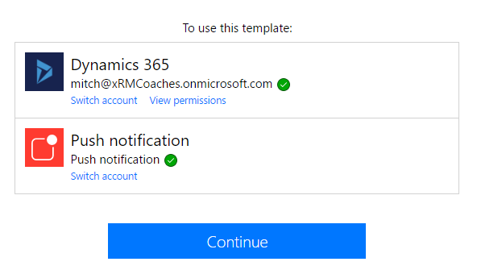
Step 2

Slide 17
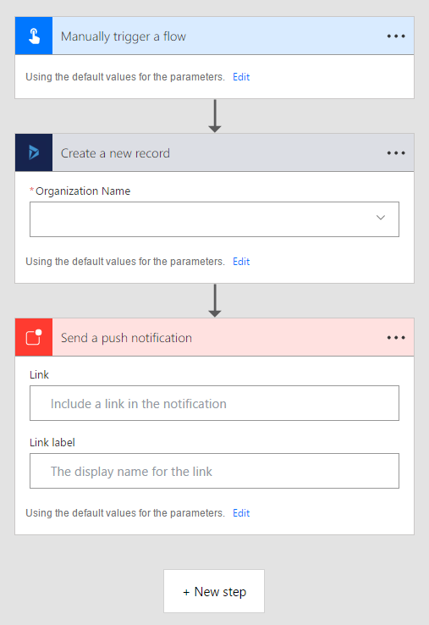
Step 3

Slide 18
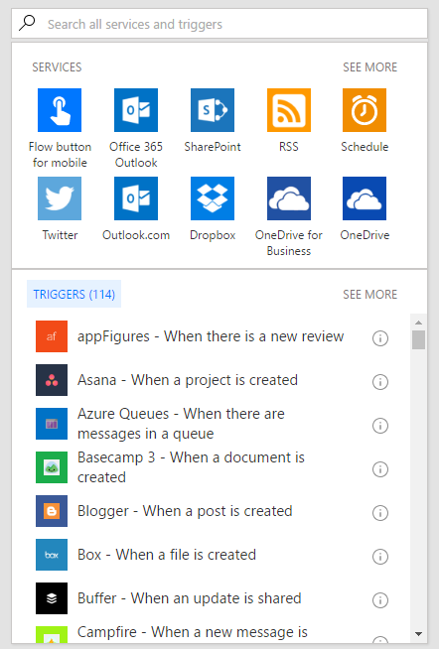
Creating a Flow from Scratch

Slide 19
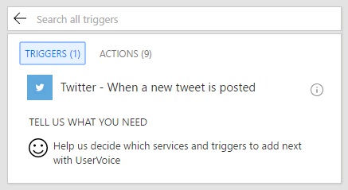
Step 2

Slide 20
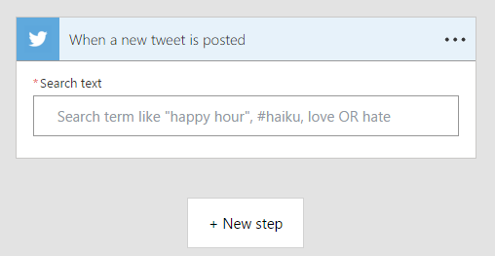
Step 3

Slide 21
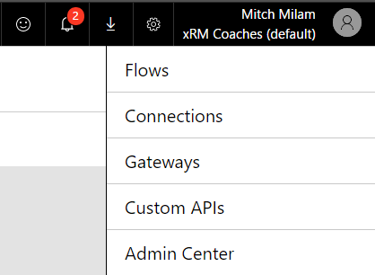
Flow Settings

Slide 22
On-Premises Gateway
Called Power BI Enterprise Gateway Service
Supports SQL Server and SharePoint
Connects to on-premises data sources only
Uses outbound connections to Azure Service Bus

Slide 23

What should you do with Flow?
Source: http://alexanderdevelopment.net/post/2016/12/10/executing-dynamics-365-workflows-from-microsoft-flow

Slide 24
Possible Guidelines
Internal CRM-related activities should stay within CRM
Flow is primarily designed for connecting Dynamics 365 to other systems

Slide 25
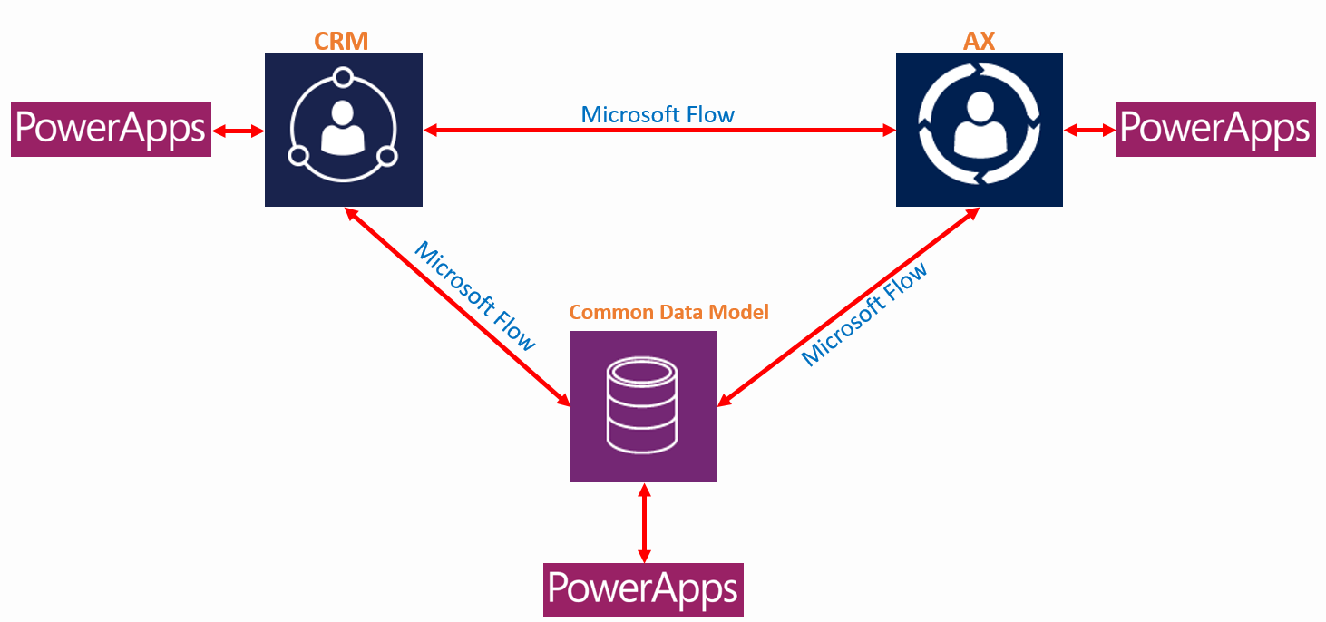
Role of PowerApps, Flow and Common Data Model in Dynamics 365

Slide 26
Questions?

Slide 27
Thank You

